Slide 1
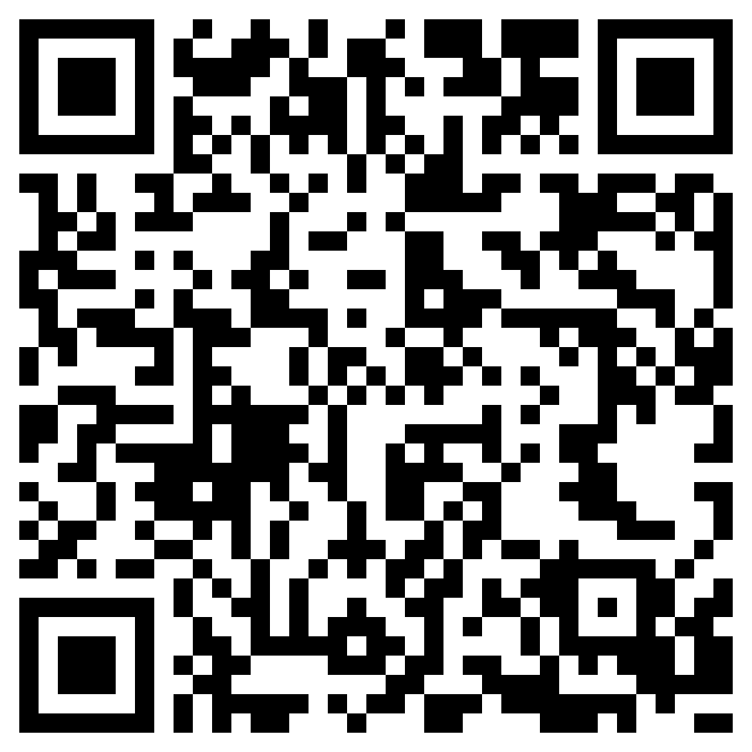
First, lets try to think of some ideas without further context – just stream of consciousness thinking
We are going to do a little experiment
My hypothesis is that, out of context or prompting, coming up with novel ideas will be hard.
The first part is simple: everyone open the URL in the QR code
(https://docs.google.com/document/d/1xKAoHRXPhJ05KPif0aCSNWa4hFib7CsztdNVHlEg5vk/edit?usp=sharing )
And, on a blank page write down all the ideas that pop into your head!
Link to Google Doc
for ideas, no context

Slide 2



Assessing ideas: the forest, the trees, and the larger ecosystem of which both are a part
By Aaron E-J

Slide 3




What to do if you are out of ideas?
Placing ourselves in novel situations
Roll playing (either about something related to the topic just in a different context, or something completely different)
Talking to people you don't normally talk to
Getting exercise
Meditating
Do you have other ways of thinking of new ideas that you have used when you were in a rut?

Slide 4
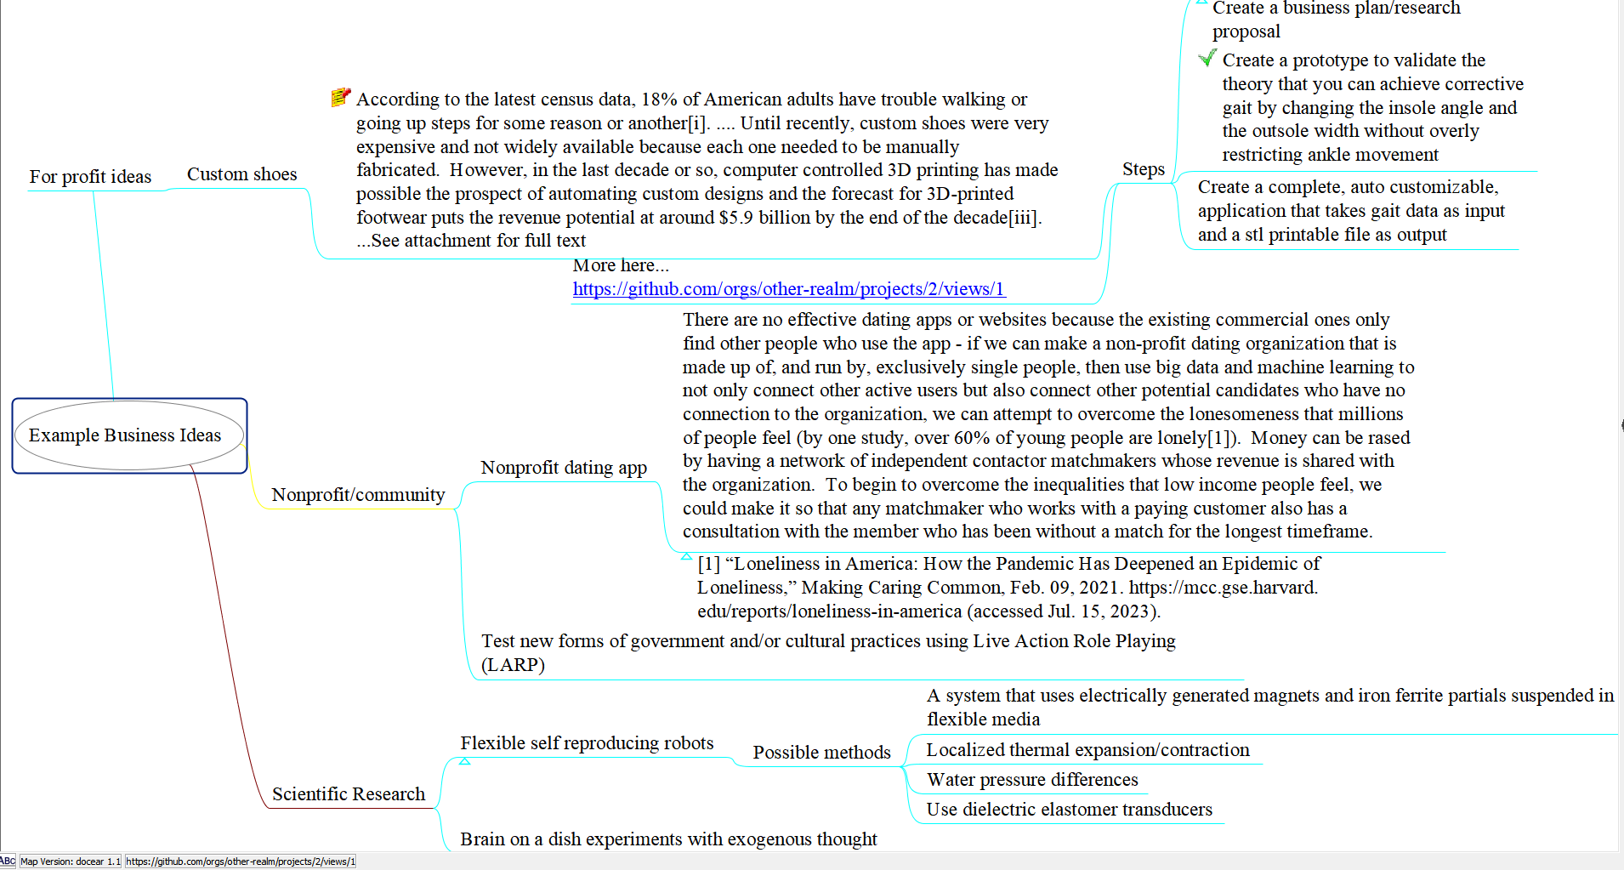
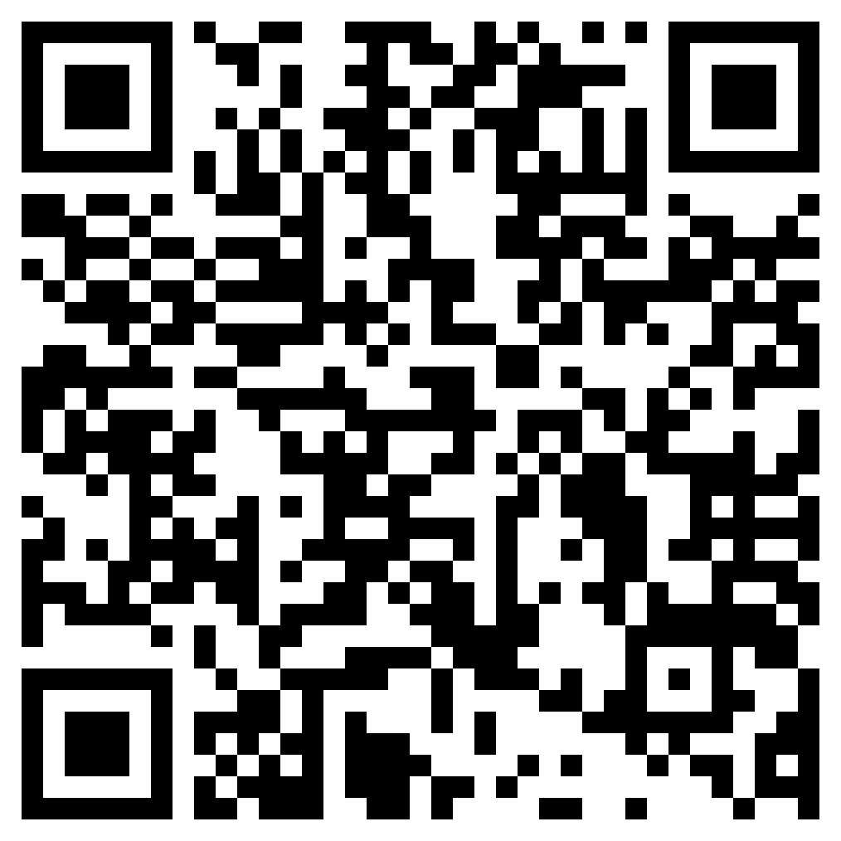
Round 2, after some examples and ideas
A QR code to the
Google doc

Slide 5
Analyze The Ideas
Efficacy?
Usefulness in society?
Are there already solutions that fulfill this challenge?
How many people are likely to benefit if the idea is realized? How did you arrive at that conclusion?
Will it be solving an unmet need, fulfilling an insatiable desire, or fulfilling an obligation?
Is there enough will and internal interest to sustain the amount of effort required for implementing the idea?
How can we work together to leverage our individual strengths and make each idea more achievable than if we were working alone?
How long and how difficult will it be to become a reality? Is it worth this effort?

Slide 6
Assignment
Continue brainstorming some more ideas on the shared Google doc and how they fit in with those we identified in class. Then, select the idea you want to research and develop further (it doesn’t need to be one you thought up, it can be anything on the list we created) and submit it on canvas along with a brief description of some of the reasons you decided go choose it based on the questions in the previous slide, before the next class. Make sure everyone submits their own idea in canvas, because everyone will be evaluating each other's selected ideas. Everyone will be working on each other's projects in a collaborative way in the future as well.

